Slide 1


Charge Injection System (CIS) Update
Katie Hughes, Dawit Belayneh
The University of Chicago
December 13, 2021

Slide 2
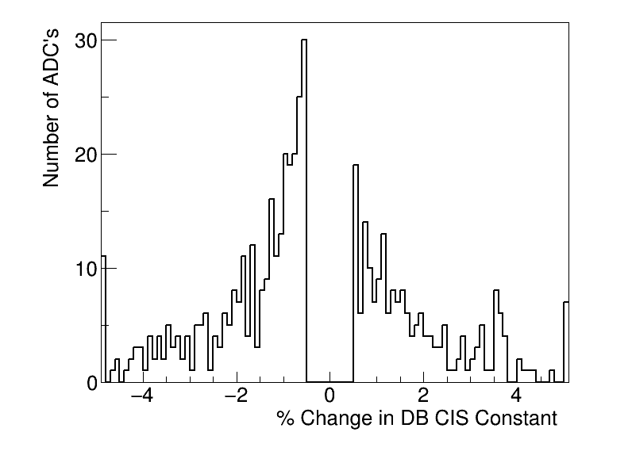
Summary
Updated on Dec. 6
CIS runs from Oct. 28 - Nov. 27
505 channels in update
419 good
15 with >5% change
18 masked
68 affected
Notes:
Channels in update is much larger than usual (~125)

Slide 3
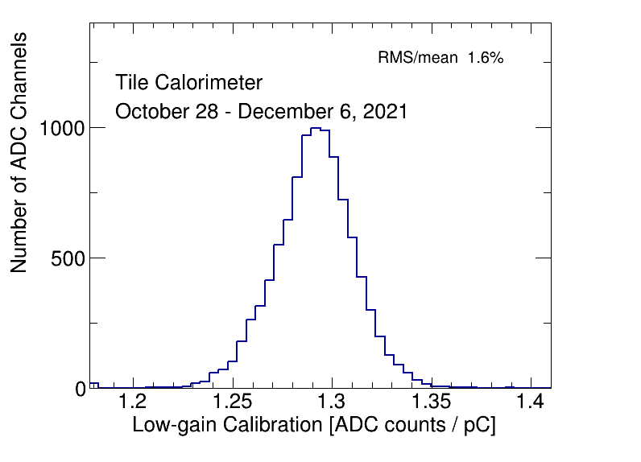
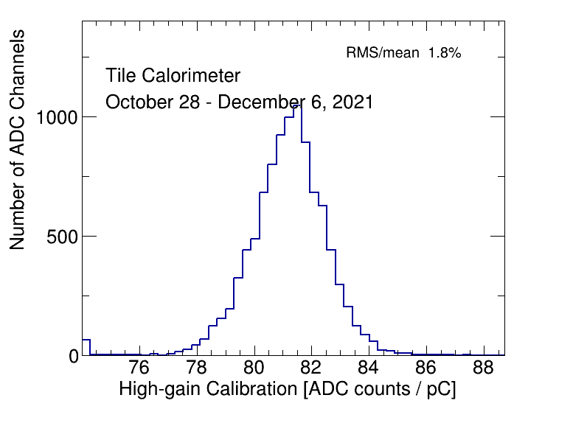
CIS constant distributions

Slide 4
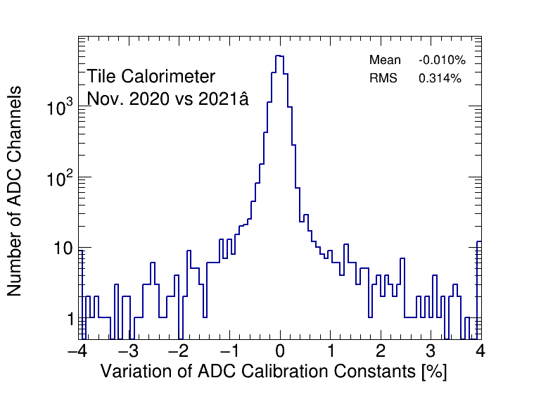
Detector stability

Slide 5
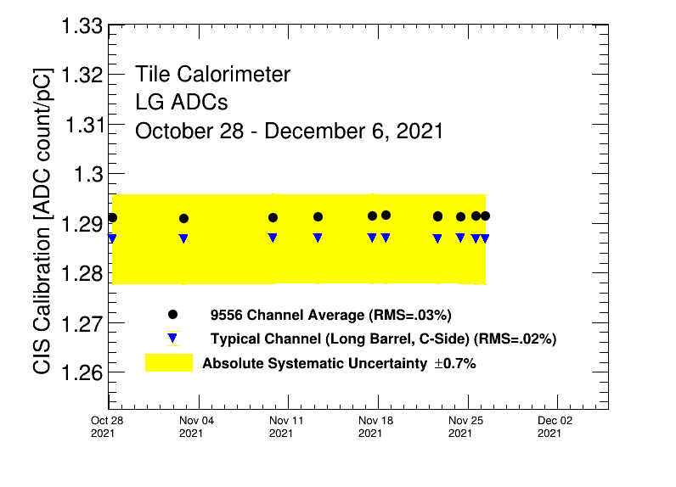
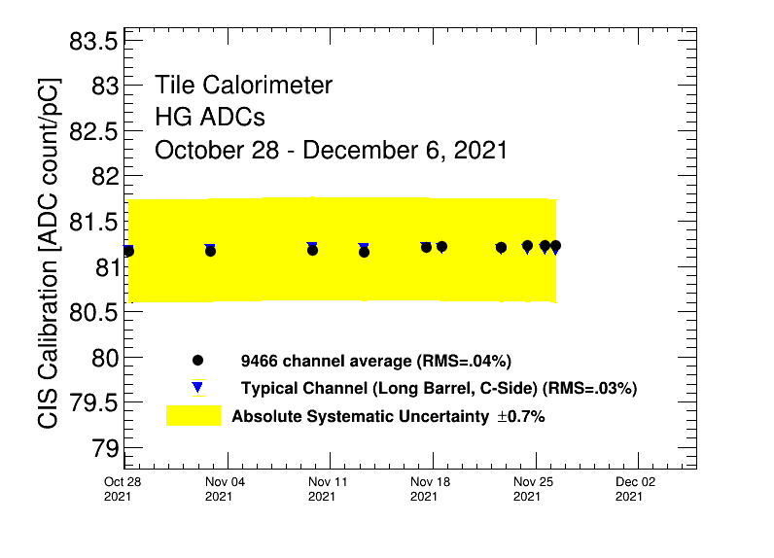
CIS constant stability

Slide 6
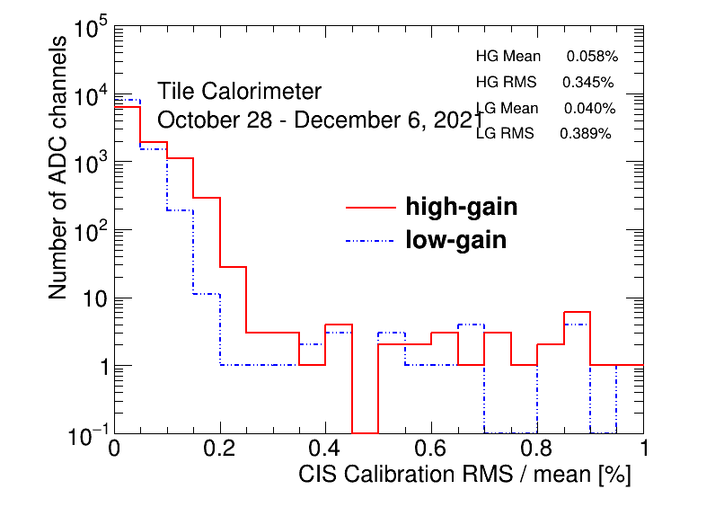
CIS constant RMS/mean

Slide 7
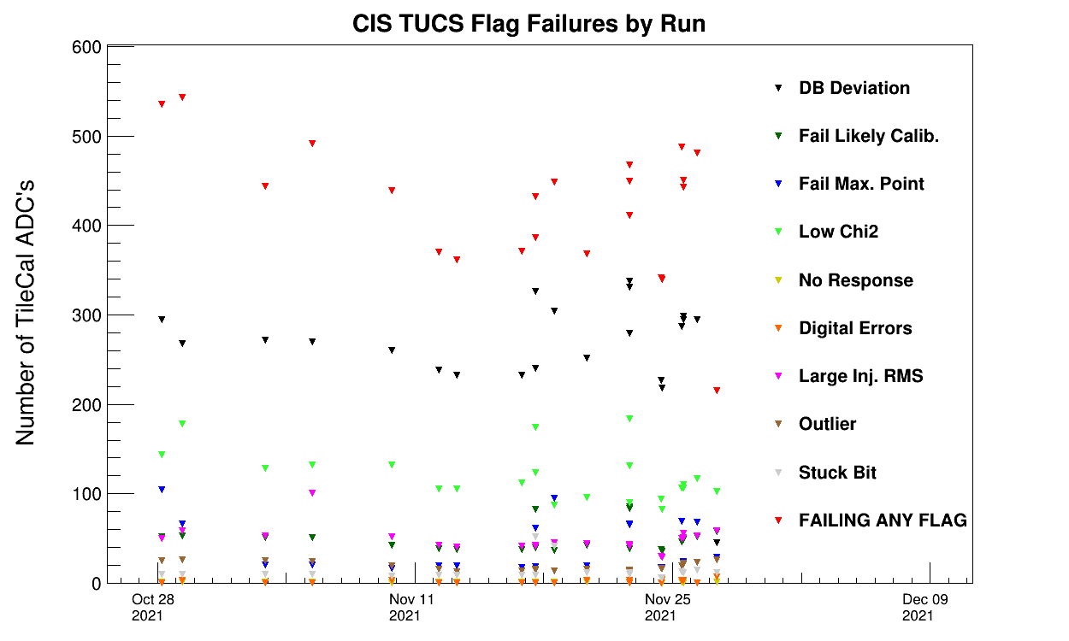
CIS TUCS Quality Flags

Slide 8
Interesting channel behaviour

Slide 9
Channels Far from Detector Avg
Highgain (Avg should be 81)
EBA_m06_c20_highgain: 74.57
EBA_m39_c31_highgain: 73.06
EBA_m50_c31_highgain: 74.07
EBC_m18_c36_highgain: 28.65
EBC_m37_c40_highgain: 73.55
EBC_m43_c36-41
LBA_m62_c26_highgain: 100.06
LBC_m01_c25_highgain: 73.28
LBC_m41_c25_highgain: 46.91
LBC_m52_c18_highgain: 102.24
Lowgain (Avg should be 1.29)
LBC_m23_c20_lowgain: 1.61
All of these were present in the last CIS update as well.

Slide 10
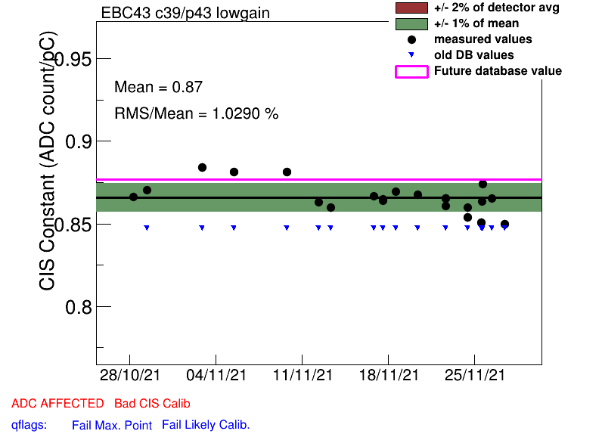
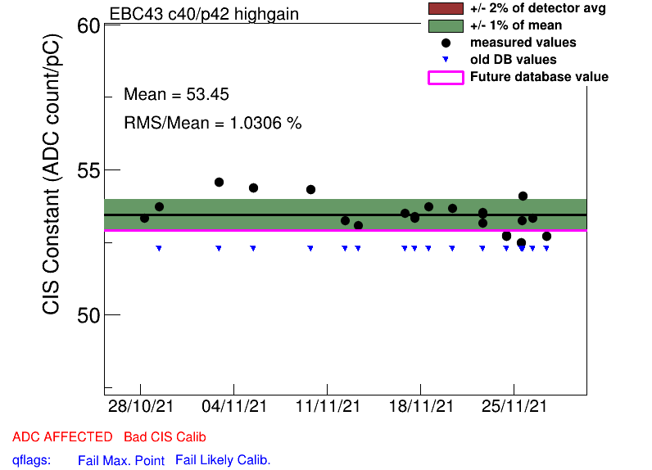
EBC_m43_c36-41
Unusually low and same pattern across all channels/both gains. Same issue in the last CIS update. Flagged as Minor Problem in some DQ reports.

Slide 11
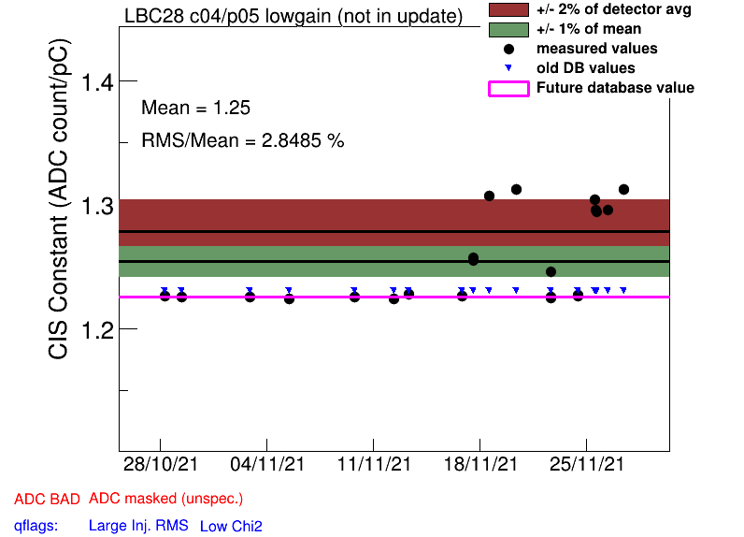
High Scatter Channels
EBC_m13_c03_lowgain
EBC_m22_c16_lowgain
EBC_m30_c11
EBC_m43_c36-41
EBC_m56_c41_lowgain
LBA_m02_c06
LBA_m03_c17_lowgain
LBA_m42_c07_highgain
LBA_m45_c06_highgain
LBA_m62_c26_highgain
LBC_m01_c25_highgain
LBC_m13_c15
LBC_m16_c29_highgain
LBC_m19_c22_lowgain
LBC_m23_c20_lowgain
LBC_m28_c04_lowgain
LBC_m41_c25_highgain
LBC_m46_c04_highgain
LBC_m47_c35_lowgain
LBC_m52_c18_highgain
LBC_m57_c06_highgain
LBC_m62_c08_highgain
Notes:
Has been marked in DQ reports as minor problem

Slide 12
Channels with >5% dev. from last database value
EBA_m49_c00_highgain: 6.60%
EBA_m64_c03_highgain: 71.87%
EBC_m09_c40_highgain: -49.53%
EBC_m11_c31_lowgain: 101.33%
EBC_m18_c36_lowgain: 7.09%
EBC_m23_c31_lowgain: 22.29%
LBA_m42_c12_lowgain: 20.09%
LBC_m23_c20_lowgain: -12.65%
LBC_m41_c42_lowgain: 5.35%
LBC_m47_c35_lowgain: -13.10%
Notes:
EBC_m23_c31_lowgain had a large jump mid october
EBA_m64_c03_highgain: 71.87%: went from half gain back to normal

Slide 13
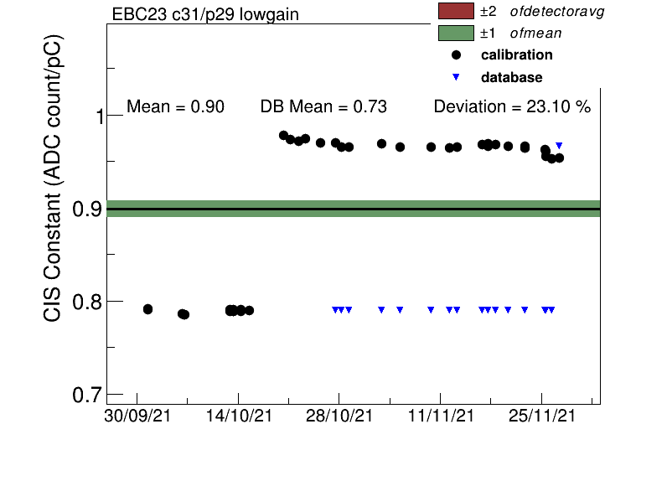
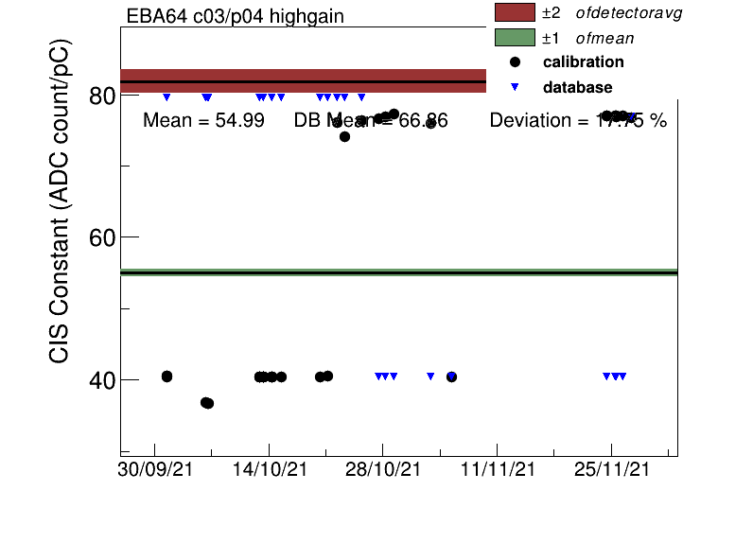
Some highdev chs over the last 2 months

Slide 14
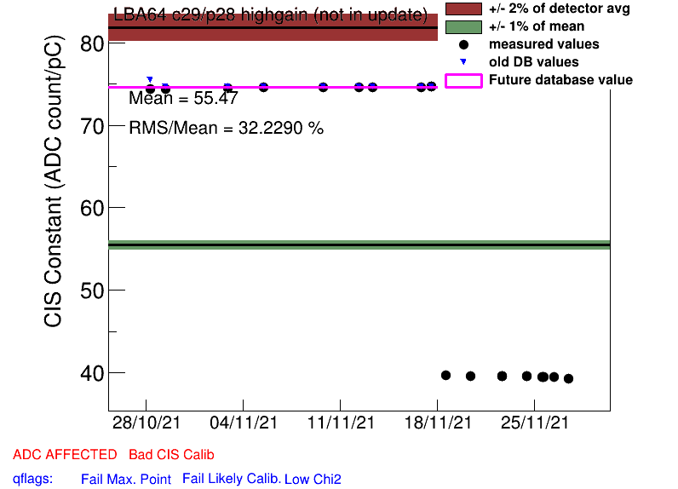
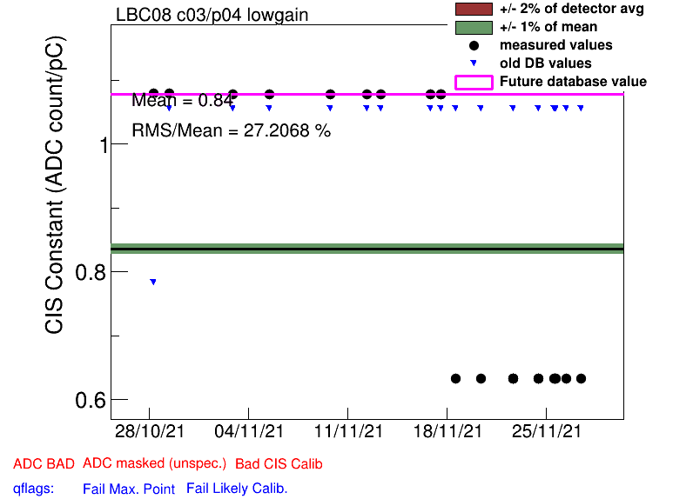
Half Gain Channels
EBA_m15_c08_highgain
EBA_m16_c00_highgain
EBA_m36_c15_highgain
EBA_m48_c31_lowgain
EBC_m09_c40_highgain
EBC_m18_c04_lowgain
EBC_m21_c36_lowgain
EBC_m56_c41_lowgain
LBA_m37_c19_highgain
LBA_m64_c29_highgain
LBC_m08_c03_lowgain
LBC_m19_c22_lowgain
LBC_m47_c35_lowgain
Red: New this CIS update

Slide 15
Some Channels with Constant Shifts
EBC_m50_c01_lowgain, highgain: Nov. 24
LBA_m05_most_lowgain, highgain: Nov. 19
LBA_m15 c02,c24_highgain: Nov. 19:
LBA_m21_c32-35_lowgain, highgain: Nov. 17
Flagged in DQ report
LBA_m55_most_highgain: Nov. 19
LBC_m13_c18-23_lowgain, highgain: Nov. 11
Corresponds to maintenance
LBC_m59_c24-29_lowgain, highgain: Nov. 19
Corresponds to maintenance
Notes:
LBA 05 and 15 went to green in the DQ report on nov 29
LBA 21 had major laser problem on Nov 15 DQ report and was reduced to minor problem on Nov 17 one

Slide 16
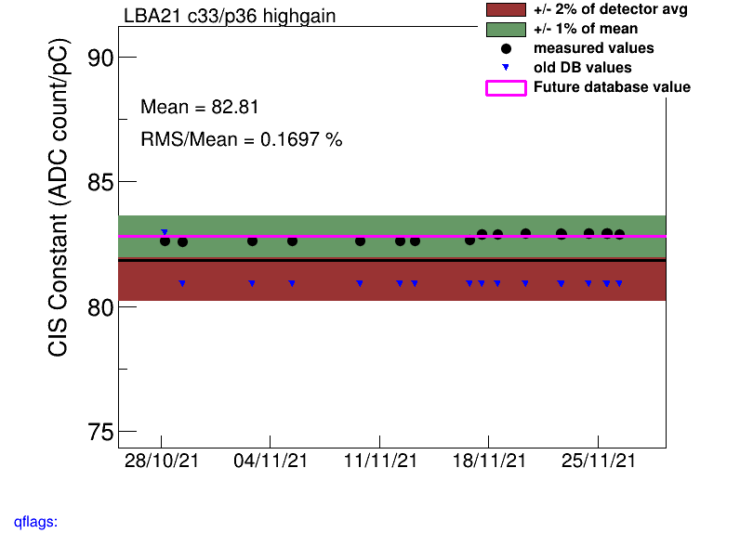
LBA_m21
Had a major laser problem on Nov 15 DQ report. Reduced to a minor problem in the Nov 17 report.
Laser problem reduced to “minor”

Slide 17
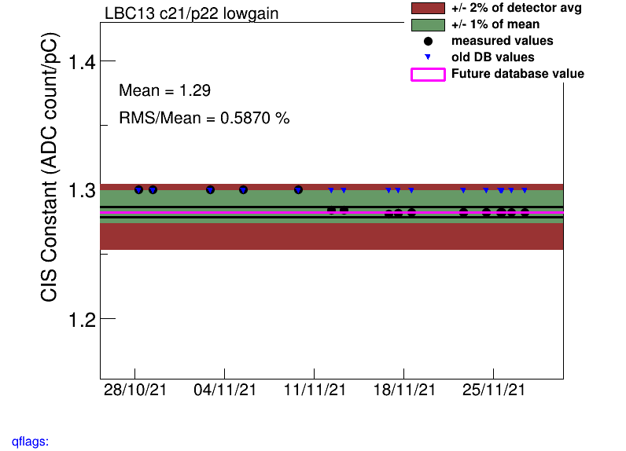
LBC_m13
Opened on Nov. 11
https://pcata007.cern.ch/elog/Maintenance/4886
Maintenance

Slide 18
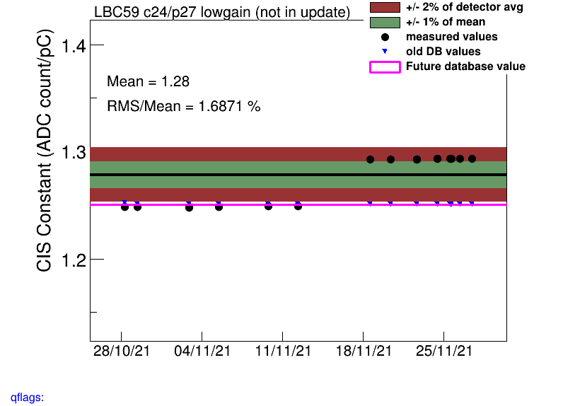
LBC_m59
Opened on Nov. 19
https://pcata007.cern.ch/elog/Maintenance/4898
Maintenance

Slide 19
COOL Flag Updates
Add BadCIS
EBA_m48_c37_highgain
EBC_m16_c36_lowgain
EBC_m16_c39_highgain
EBC_m57_c11_highgain
EBC_m61_c08_lowgain
EBC_m63_c15_highgain
EBC_m63_c15_lowgain
LBA_m42_c07_highgain
LBA_m52_c36_lowgain
LBC_m04_c14_highgain
LBC_m10_c37_highgain
LBC_m20_c37_lowgain
LBC_m28_c04_lowgain
LBC_m46_c04_highgain
LBC_m49_c26_highgain
LBC_m49_c26_lowgain
LBC_m52_c34_highgain
Remove BadCIS
EBA_m08_c10_highgain
EBA_m09_c16_highgain
EBA_m19_c41_highgain
EBA_m63_c15_highgain
EBC_m09_most
EBC_m37_c39_highgain
LBA_m27_c05_lowgain
LBA_m41_c05_lowgain
LBA_m43_c21_lowgain
LBA_m52_c02_lowgain
LBA_m63_c24-35_highgain
LBC_m08_c32_lowgain
LBC_m17_c11_highgain

Slide 20
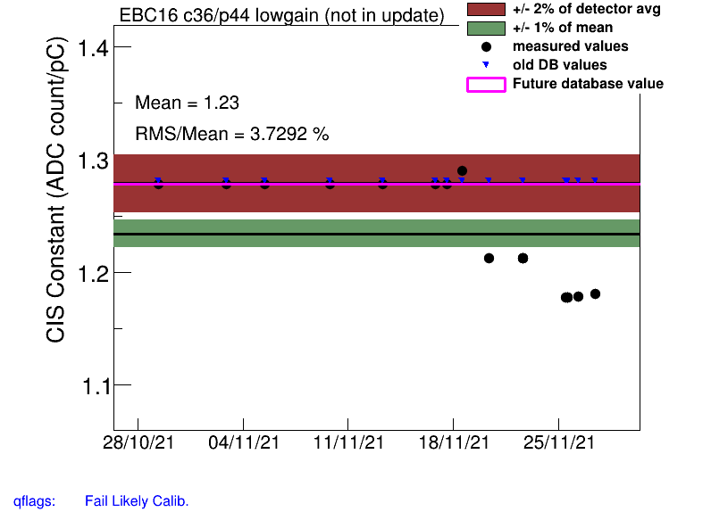
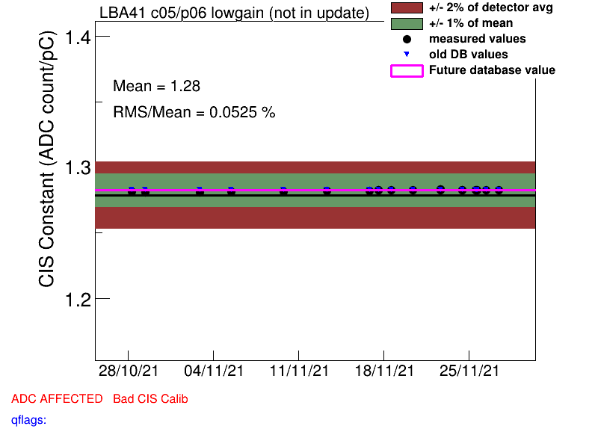
Add BadCIS
Remove BadCIS

Slide 21
